Slide 1
Open science and data sharing for gravitational wave experiments
Trovato,
APC, CNRS/IN2P3, Univ. Paris Diderot

Slide 2
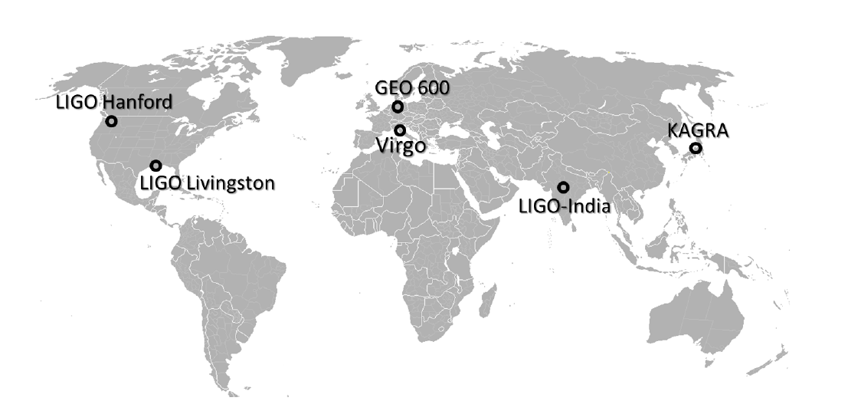
Gravitational waves detectors
Gravitational waves:
‘ripples’ in the fabric of space-time caused by accelerating masses such as colliding black holes, exploding stars, and even the birth of the universe itself.
transverse waves that travel at the speed of light
A wave stretches the space in one direction and squeezes in the perpendicular direction, then reverses the distortions
planned
under construction
Typically of order 10 ⁻²¹ or less!
Notes:
Gravitational waves are ‘ripples’ in the fabric of spacetime
caused by accelerating masses such as colliding black holes,
exploding stars, and even the birth of the universe itself.
Albert Einstein predicted the existence of gravitational waves
in 1916, derived from his General Theory of Relativity.
Einstein’s mathematics showed that massive accelerating
objects would disrupt spacetime in such a way that waves of
distorted space would radiate from the source. These ripples
travel at the speed of light through the universe, carrying
information about their origins, as well as clues to the nature
of gravity itself. Two black holes in mutual orbit will revolve
around each other emitting gravitational waves and losing
orbital energy as illustrated in Figure 1. Over time, the energy
loss causes the stars to move closer together and orbit around
each other faster and faster until they eventually merge
together, or coalesce. This type of merger has never before
been directly observed, and it is the type of event that emitted the gravitational waves detected by LIGO on September 14, 2015.

Slide 3
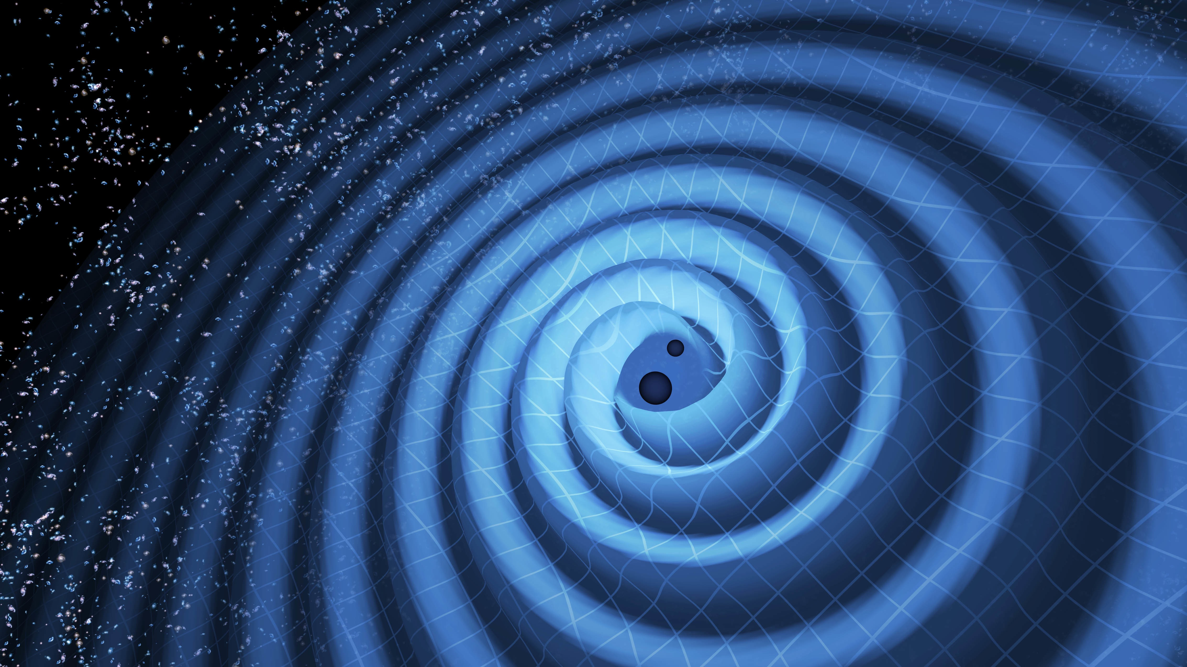
What is LOSC
LOSC = LIGO Open Science Center (new name involving also Virgo under discussion)
www.gw-openscience.org or www.losc.ligo.org
LOSC provides access to LIGO and Virgo data, as well as documentation, tutorials, and online tools for finding and viewing data.
Data for long periods of data taking at the moment available only for S5 (2005-2007) and S6 (run 2009-2010) → LIGO only
The observation run O1 (run 2015-2016) will be released soon → LIGO only
Gravitational wave data surrounding confirmed discoveries delivered:
GW150914 → first detection, LIGO only, BBH, run O1
LVT151012 → candidate BBH (significance about 2𝞂), LIGO only, run O1
GW151226 → LIGO only, BBH, run O1
GW170104 → LIGO only, BBH, run O2
GW170608 → LIGO only, BBH, run O2
GW170814 → LIGO+Virgo, BBH, run O2
GW170817 → LIGO+Virgo, BNS, run O2
A catalogue paper for O2 is in preparation (several months still needed) → catalogue web-page will follow
Virgo joined the observation run in August
BBH = Binary black Hole BNS= Binary Neutron Star

Slide 4
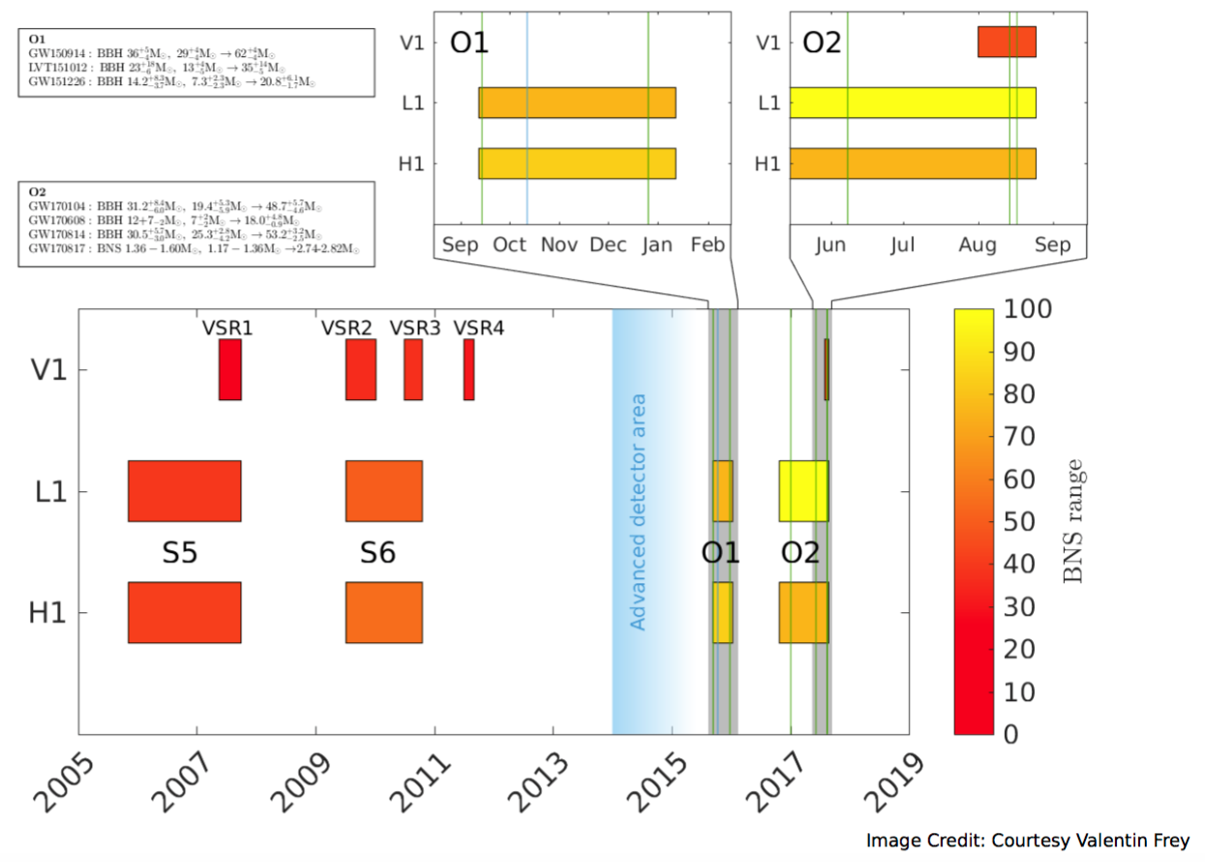
Runs timeline

Slide 5
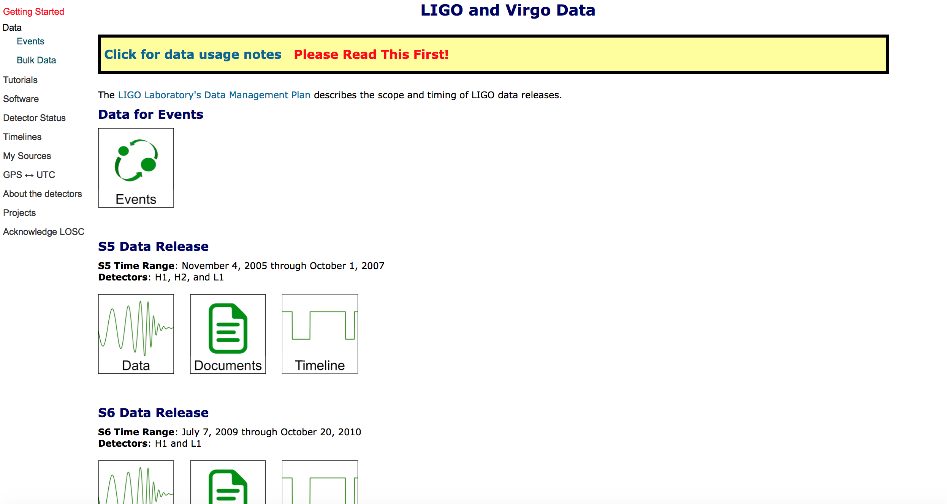
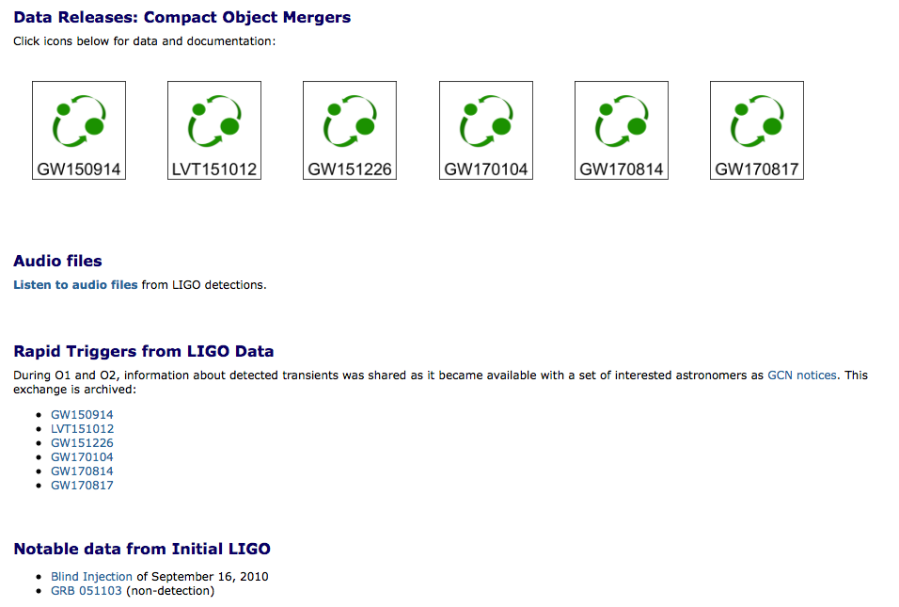
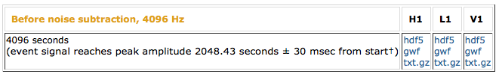
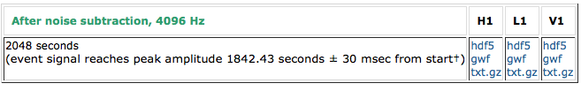
Data download
The data can be found at the web-page:
https://www.losc.ligo.org/data/

Slide 6
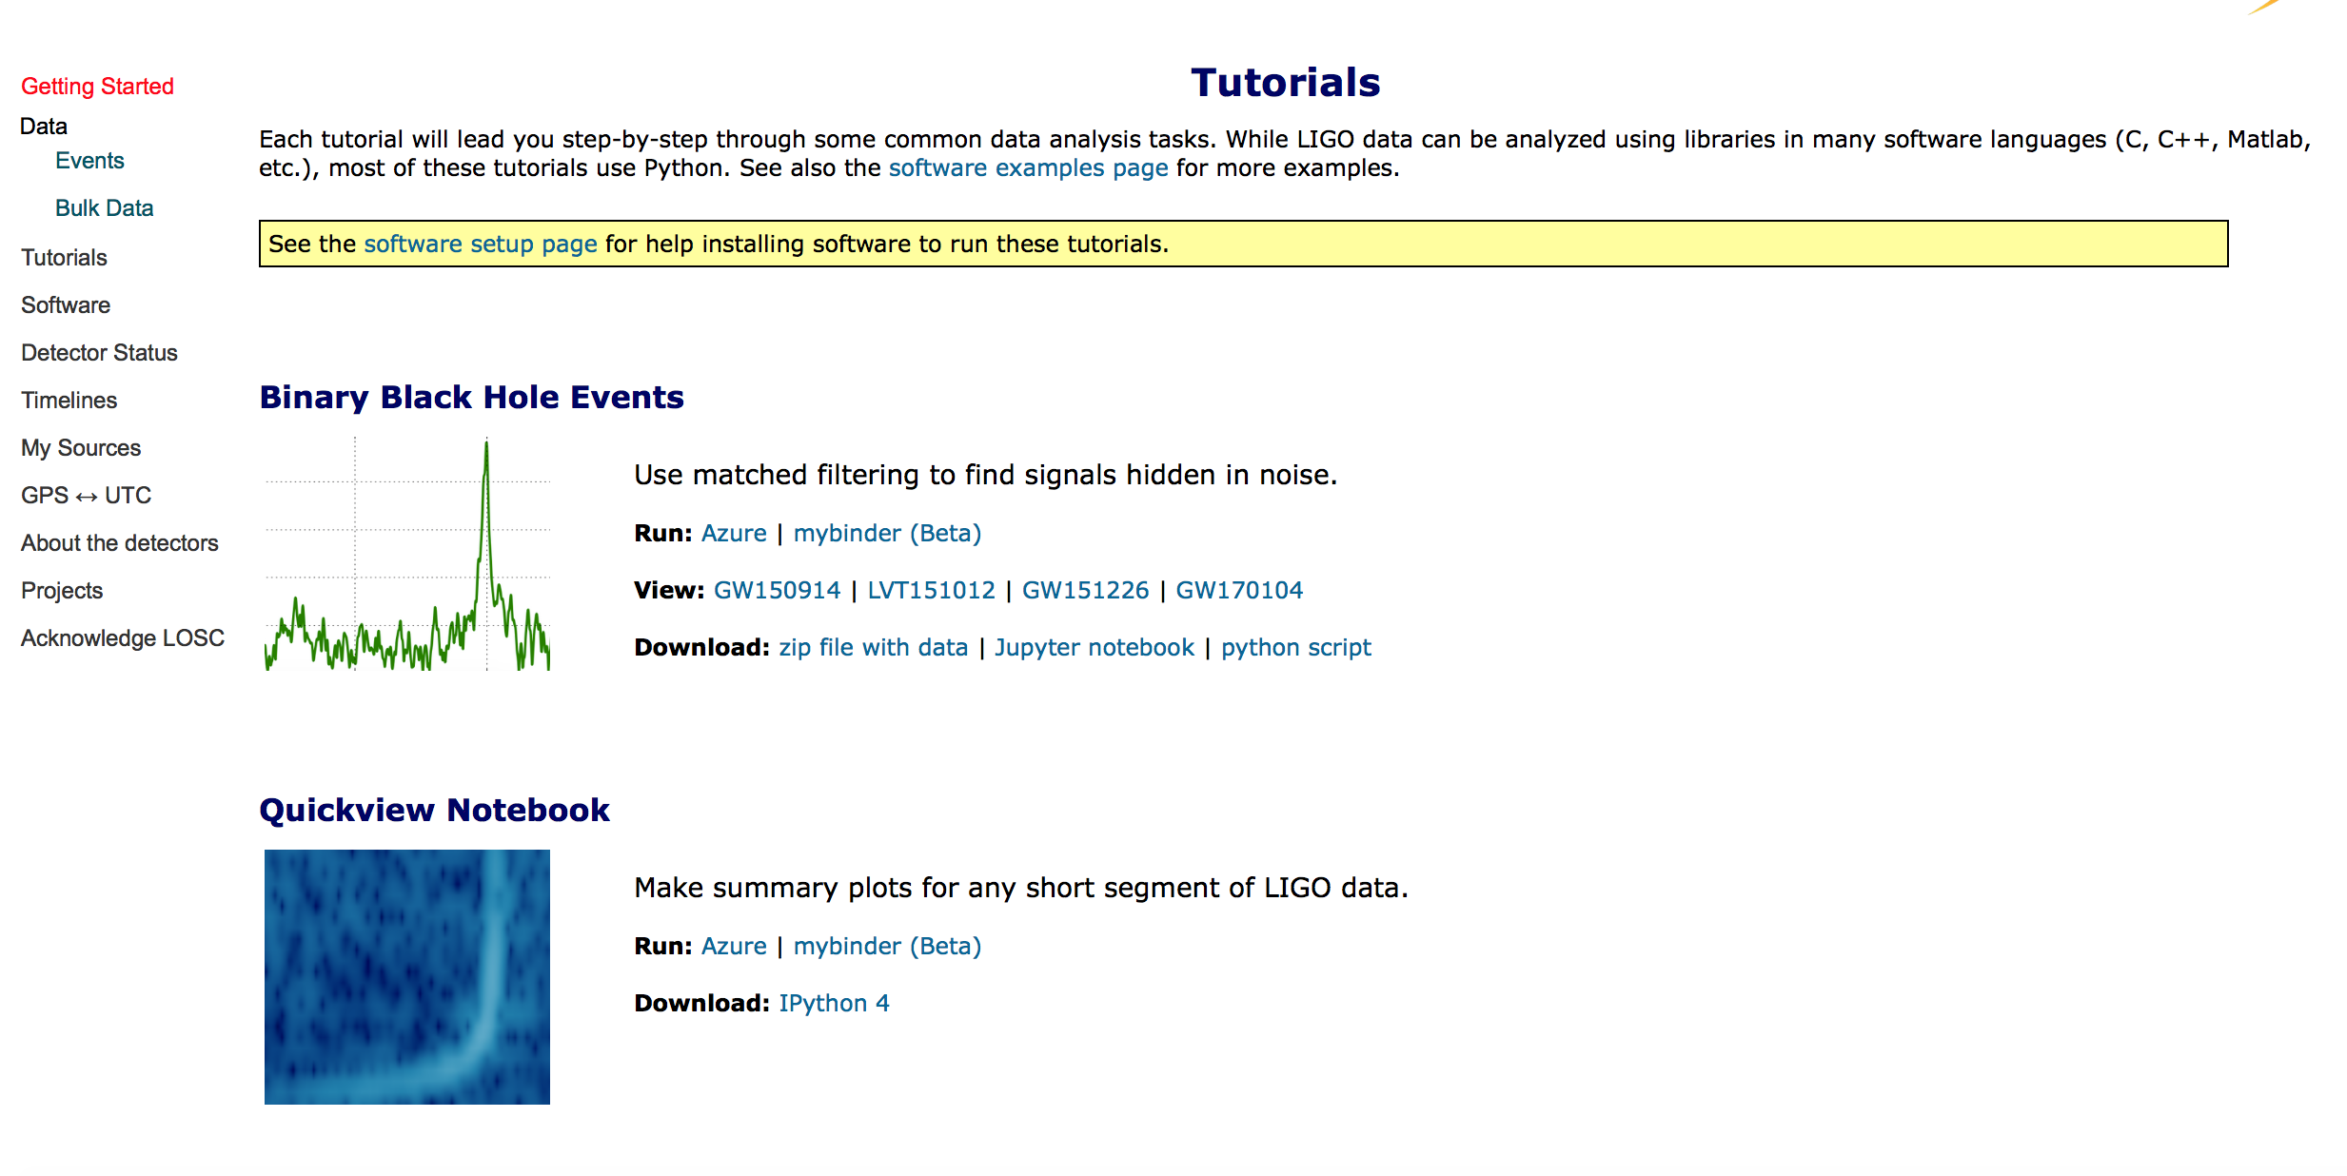
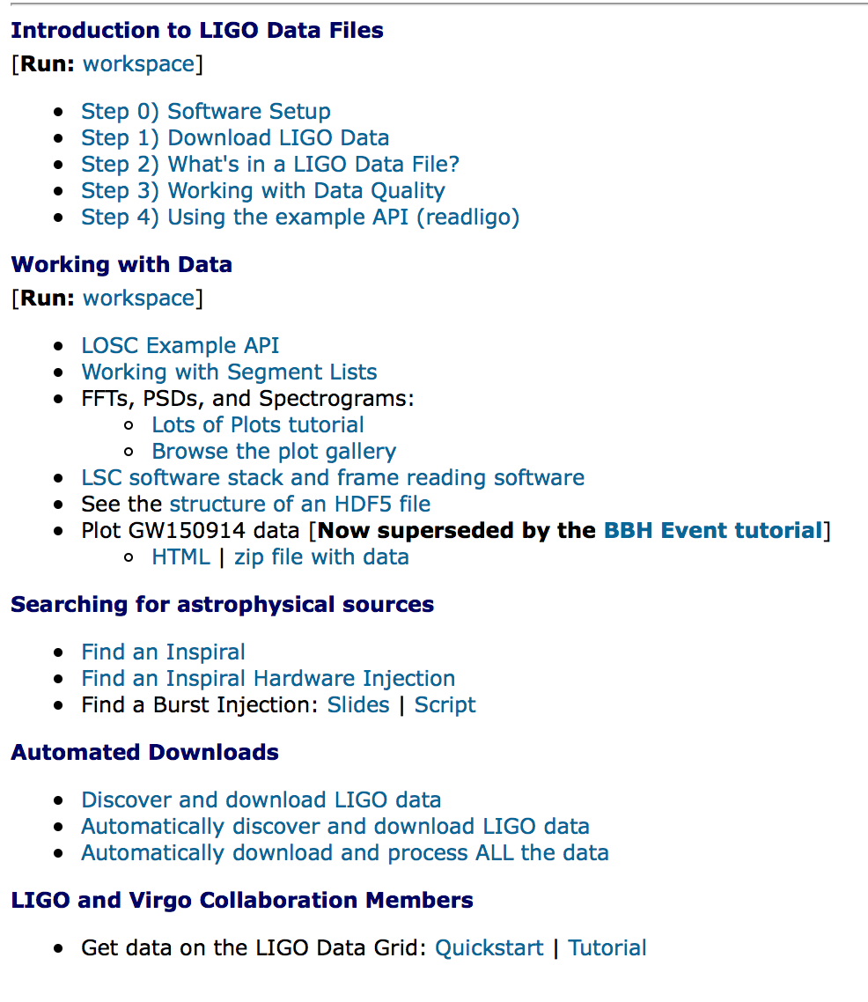
LOSC Tutorial web page
The tutorials can be found at the web-page:
https://www.losc.ligo.org/tutorials/
Short tutorials about the basics of data analysis in the form of jupyter notebooks
More specific tutorials on the data structure and how to read them

Slide 7
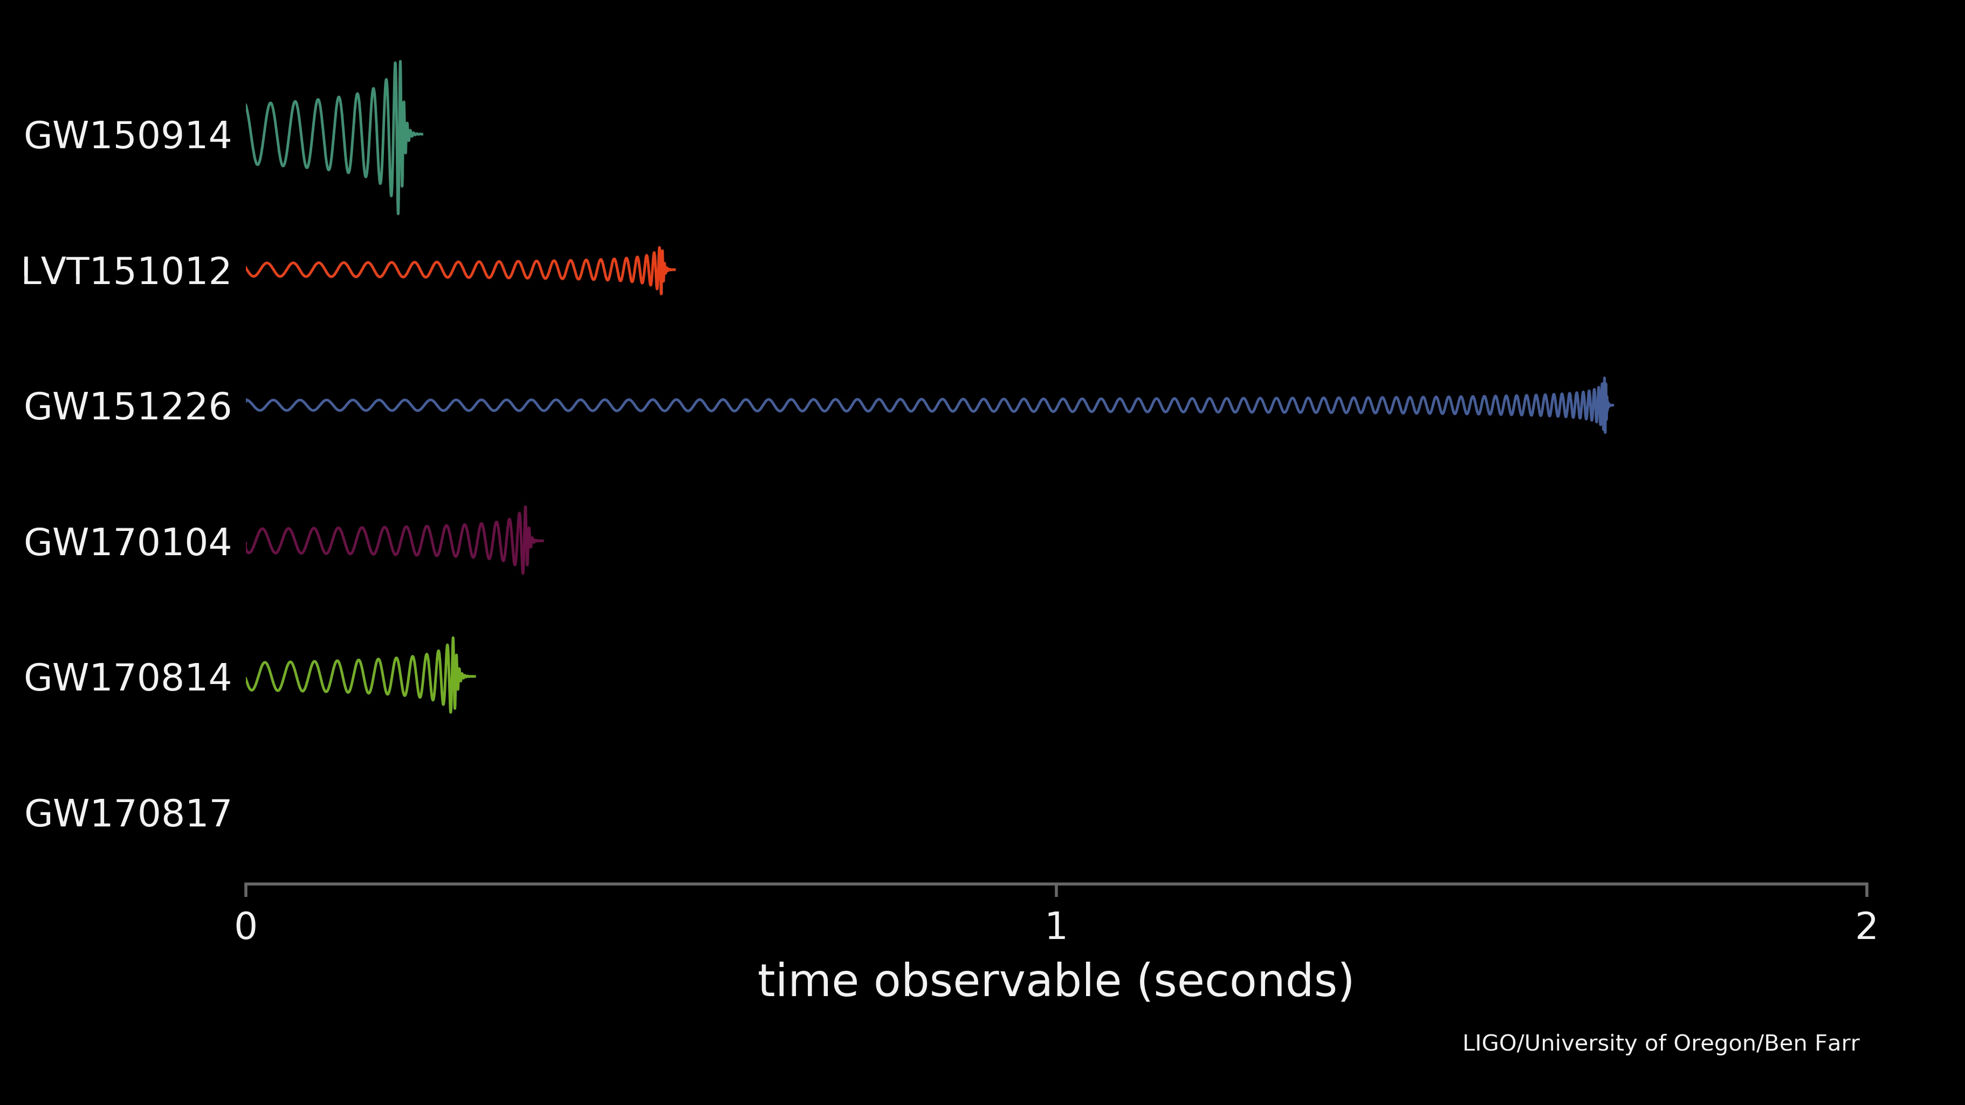
Tutorial specific for GW170817
The tutorial in the LOSC page is written specifically for BBH events
GW170817 is the first and only BNS discovered until now
BBH and BNS have different features
I adapted the tutorial to read the GW170817 public available data and I checked the template waveform ( the template is not public at the moment)

Slide 8
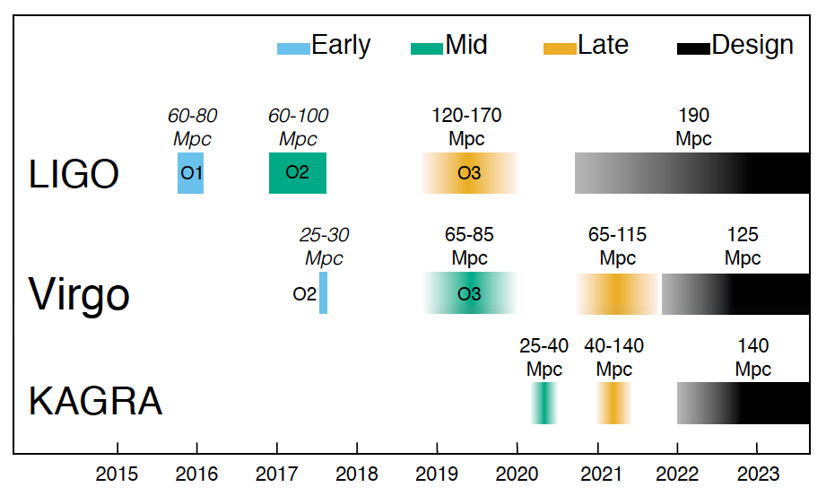
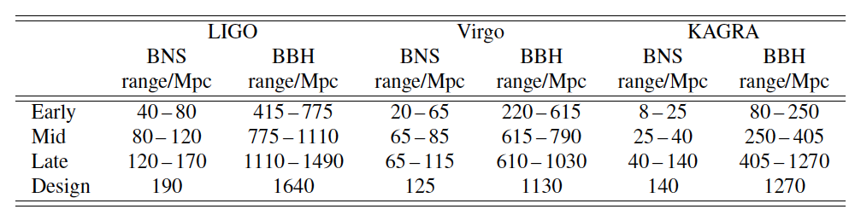
Planned detectors sensitivity evolution
arXiv:1304.0670v4
Multiplying the given range for the rate density for a source category, the corresponding detection rate can be calculated
BNS=1.4M☉+1.4M☉
BBH=30M☉+30M☉

Slide 9
Expected BBH rates
The inferred rate of BBH mergers based on LIGO/Virgo observations is:
9 – 240 Gpc⁻³ yr⁻¹ [1]
Multiplying this inferred rate for the expected range from [2], the detection rate can be calculated
O(1) events per week expected
Rough estimate:
Take this numbers only as indications of the order of magnitude
O2:
9 months long
LIGO BBH range ~800 Mpc
O(10) BBH events detected
O3:
12 months
LIGO BBH range ~1300 Mpc
Events: 10 x (1300/800)³ x 12/9 ~ 60 BBH events expected
O4:
~2 years long
LIGO BBH range ~1640 Mpc
Events: 10 x (1640/800)³ x 2/0.75 ~ 230 BBH events expected
[1] Physical review X 6,041015 (2016)
[2] arXiv:1304.0670v4
A BBH catalogue is a in the plans of the collaboration already for O2.
Contents of BBH catalogue have still to be defined. Primarily stored at losc.ligo.org

Slide 10
BBH Catalogue in Vizier
BBH catalogue also in Vizier?
GW events have different features than the typical events stored in Vizier!
POSITION:
Can we build catalog in Vizier when sky position is poorly known?
Can we use a probability sky map to define the event position? E.g. store for each event some central position with some large errors to indicate the event extension on the sky map?
If yes, can this catalog be queried? For instance, give me all BBH whose sky map overlap with direction RA, 𝛅?
WAVEFORMS:
Can the waveforms (and eventually the templates) be stored?
PARAMETERS:
Can parameters like the SNR/False alarm rate/BH masses/BH spins be stored?
If yes, is it possible to search for all events with some values or (range of values) for these parameters?
ADDITIONAL INFO:
is it possible to add for each event a link to the main papers that discuss it?
Notes:
Furthermore, there are some characteristics of GW astronomy that are fundamentally different from “traditional” electromagnetic (EM) astronomy, and this means that quantities used to summarize EM telescopes need to be adjusted for GW telescopes. Quantities such as magnitude limit, sky brightness, B-band luminosity, and Vega magnitudes need to be replaced.
One particularly important distinction between optical and GW telescopes is their differing sky response. GW telescopes are sensitive to sources on the entire sky, al- though the sensitivity varies greatly depending on the particular sky location. The average distance to which a GW telescope can detect a given source varies greatly de- pending on where the source is on the sky relative to the detector

Slide 11
Thank you
for you attention!

Slide 12
BBH vs BNS
Masses: Neutrons stars have usually messes of the order of the M☉ while black holes can have bigger masses (order few tens of M☉). As consequence binary black holes (BBH) are much "louder" and can be detected to much higher distances than the binary neutron starts (BNS)
Peak frequency: the maximum frequency of the GW is of O(10³) Hz for BNS and O(10²) for BBH → this means that the BNS signal can be listen longer analysing more cycles (Virgo and LIGO are sensible between 10 Hz and 10³ Hz)
E.m. counterpart: it is not expected that BBH have an e.m. counterpart (and have not been observed until now) while e.m. counterparts have been observed for the BNS starting the era of multi-messenger astronomy

Slide 13
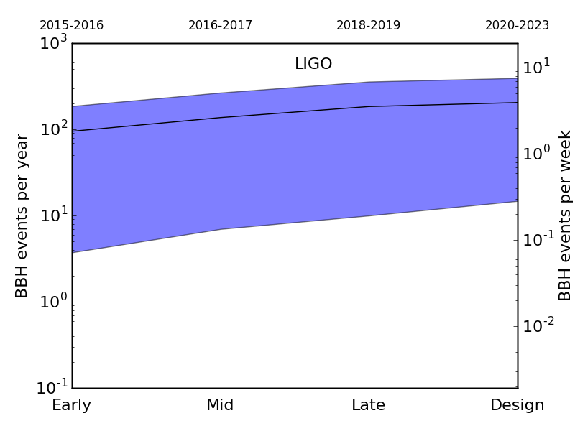
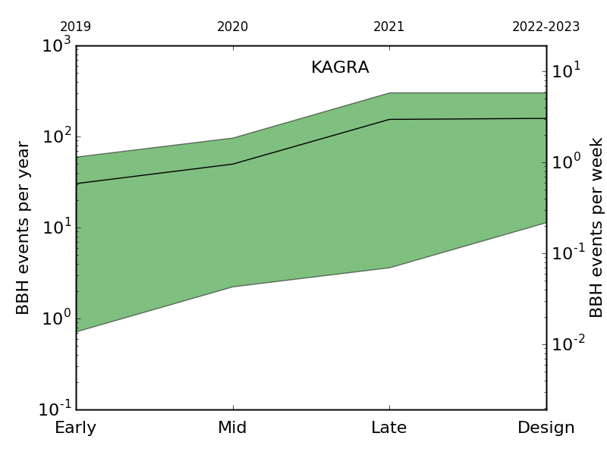
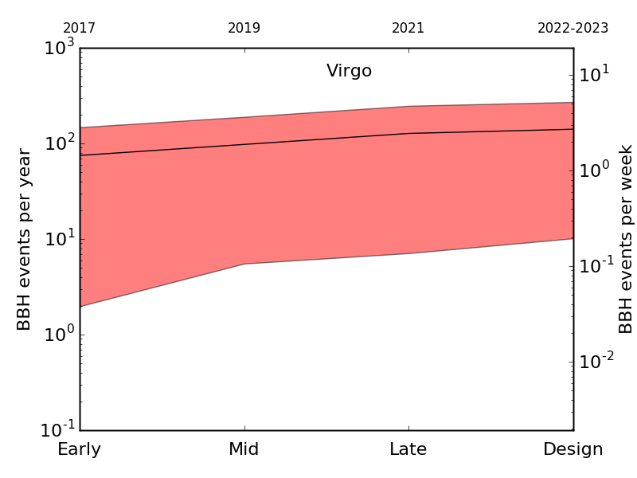
Expected BBH rates
The inferred rate of BBH mergers based on LIGO/Virgo observations is:
9 – 240 Gpc⁻³ yr⁻¹ [1]
Multiplying this inferred rate for the expected range from [2], the detection rate can be calculated
[1] Physical review X 6,041015 (2016)
[2] arXiv:1304.0670v4

